Slide 1
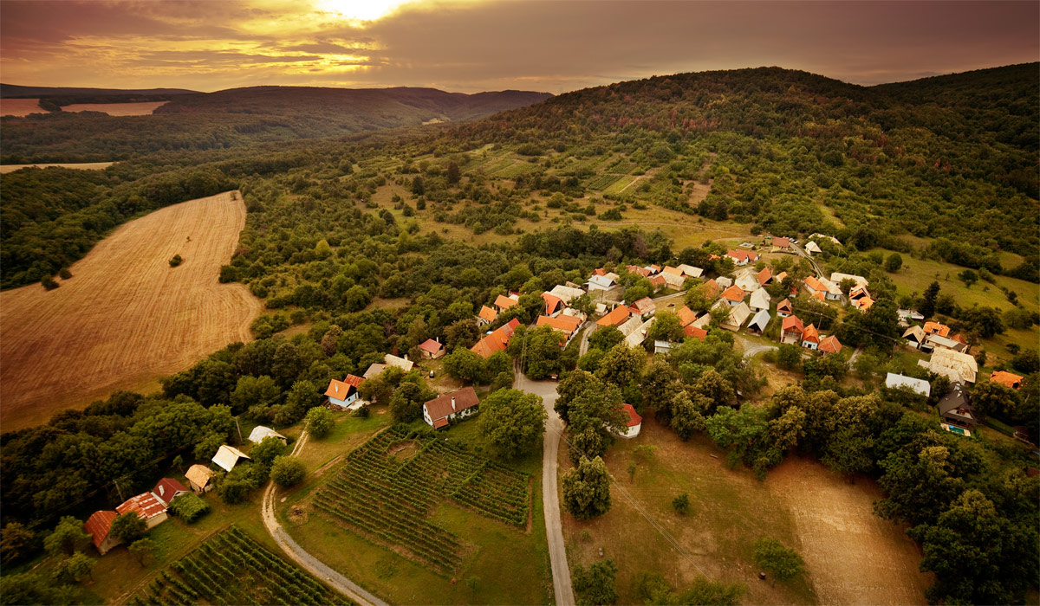
LOCAL PRODUCERS IN THE HONT REGION

Slide 2
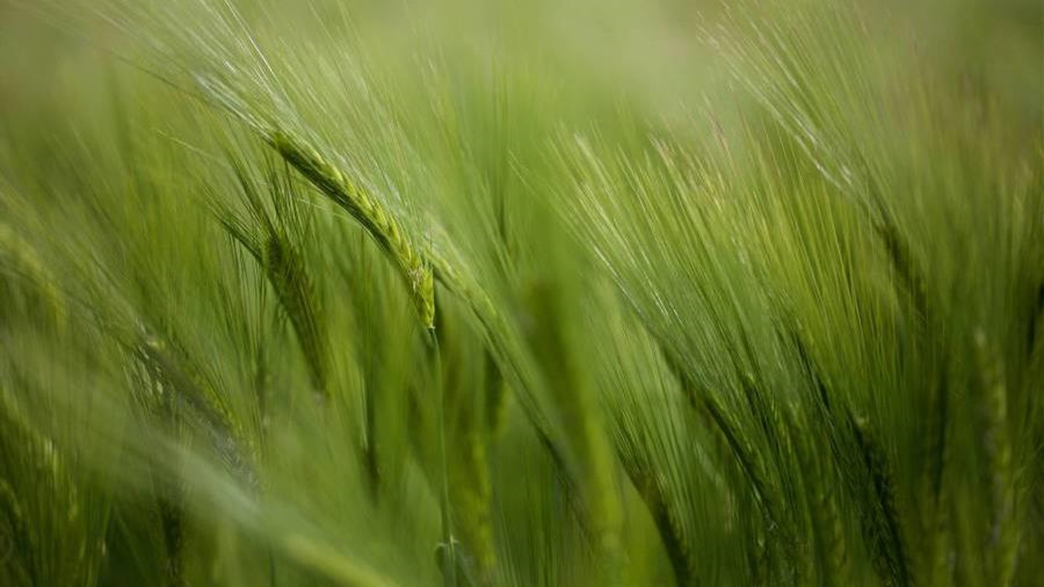
The Best of Traditional Products from Hont
Project Objective: Mapping local producers in the Hont region. Describing their products and production processes. Assessing the environmental impact of production on the region and waste management practices.

Slide 3

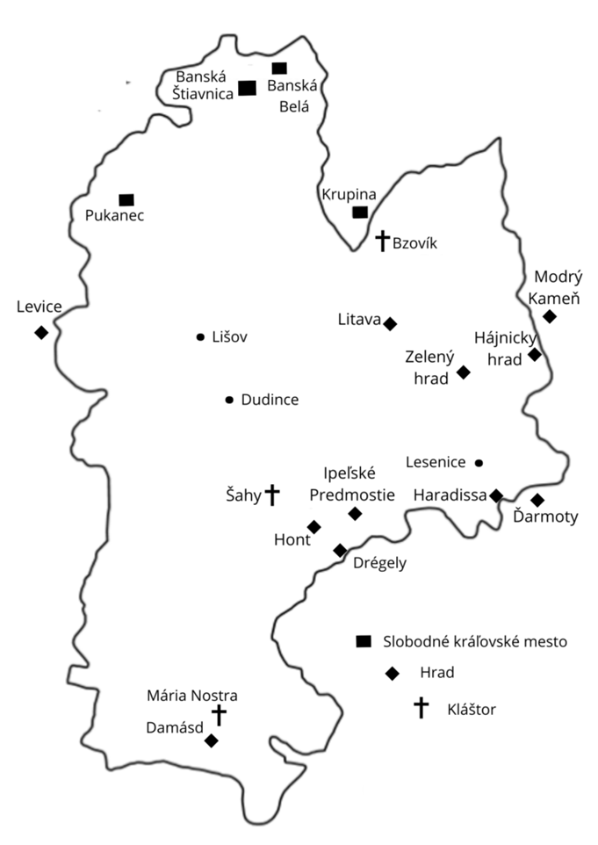

Hont is currently one of Slovakia's cultural regions. It is among the oldest Slovak regions, and its territory corresponds to the Slovak part of the former Hont County, whose last seat was in Šahy. In some tourist publications, the southern part of the region is also referred to as Poiplie. The territory borders the Slovak cultural regions of Tekov (to the west), Podpoľanie (to the north), Novohrad (to the east), and Hungary to the south.

Slide 4
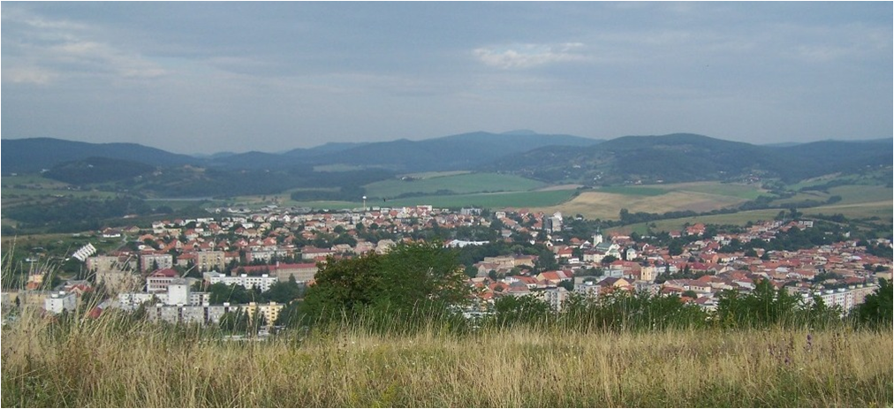
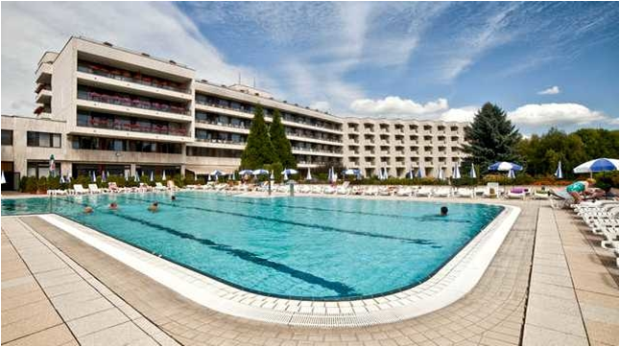
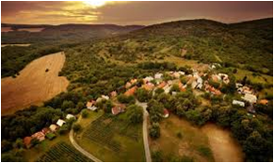
Hont

Slide 5

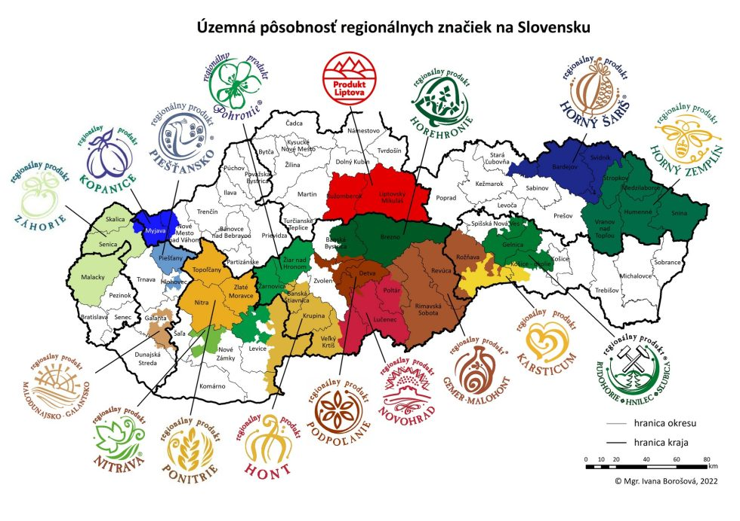
Regional Brands
Each region in Slovakia has its own brand, and the goal of labeling local products is to support traditional local products and services that, through their methods of production and service provision, also protect the environment and, ultimately, benefit everyone. In Slovakia, environmental labeling of products is implemented through the "Environmentally Friendly Product" label and the European "EU Ecolabel" scheme.

Slide 6
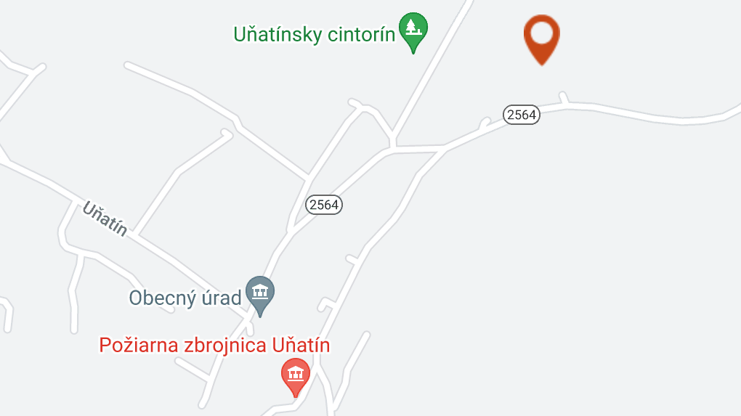
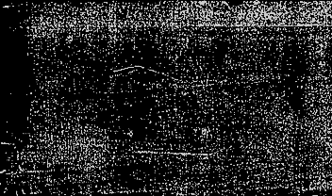
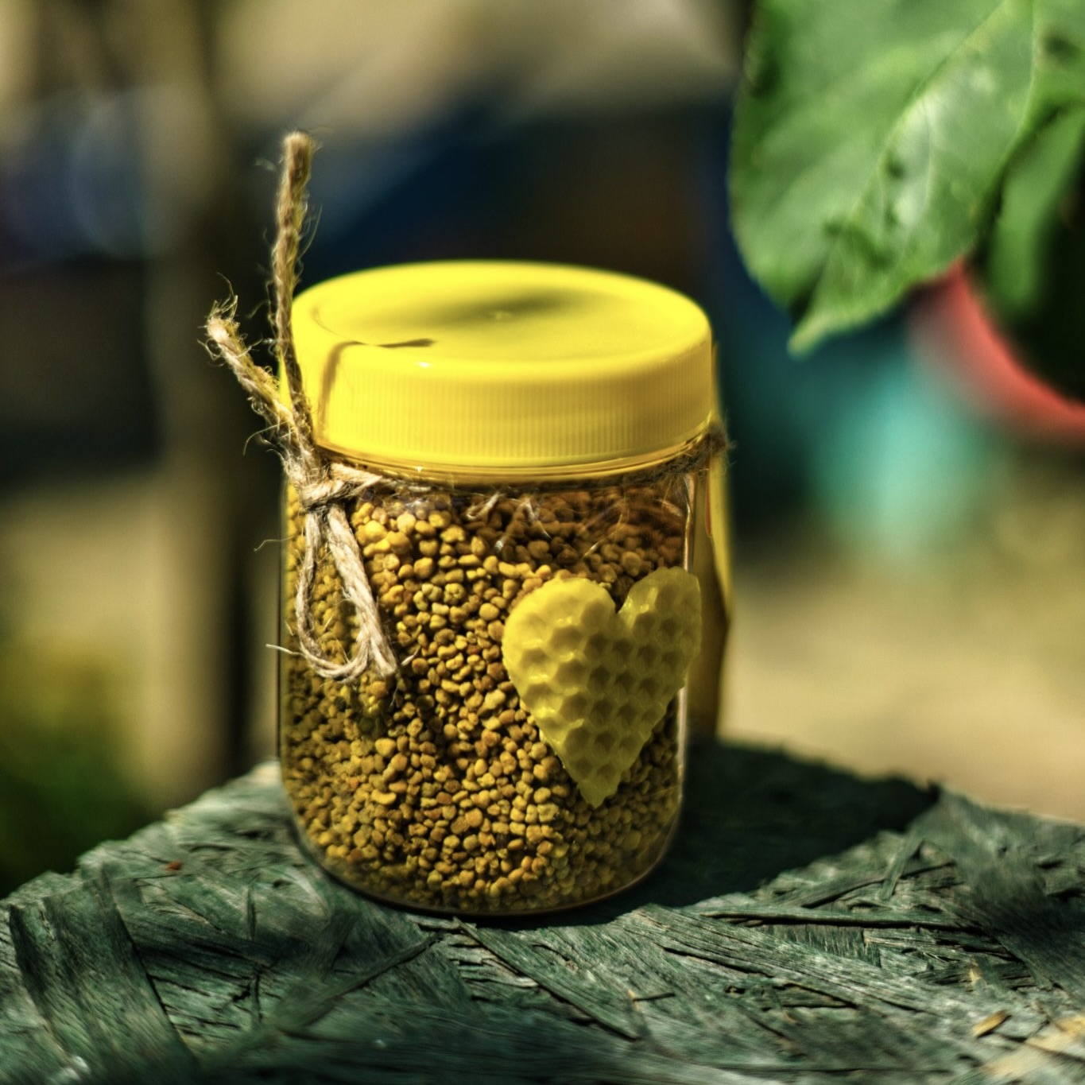


Unmedy včelárstvo Uňatín

Slide 7

Products of Unmedy Beekeeping
Unmedy Beekeeping is a family-owned company focused on producing high-quality bee products. Their offerings include:
Honey: Various types of honey, including floral, linden, acacia, and forest honey. These honeys are known for their purity, rich flavor, and high content of antioxidants and enzymes that contribute to health.
Propolis: A natural substance collected from bee hives, known for its strong antibacterial and anti-inflammatory properties. It is used in tinctures, ointments, and other natural remedies.
Beeswax: Wax collected from the hives is used to make candles, cosmetics, and balms. It is 100% natural and environmentally friendly.
Honeycomb: This product is honey in its most natural form, stored directly in the honeycomb. It is prized for its taste and texture and is often used as a delicacy or an ingredient in various dishes.
Beeswax Wraps: Eco-friendly wraps made from 100% beeswax. They are reusable, biodegradable, and serve as a natural alternative to plastic food wraps.

Slide 8
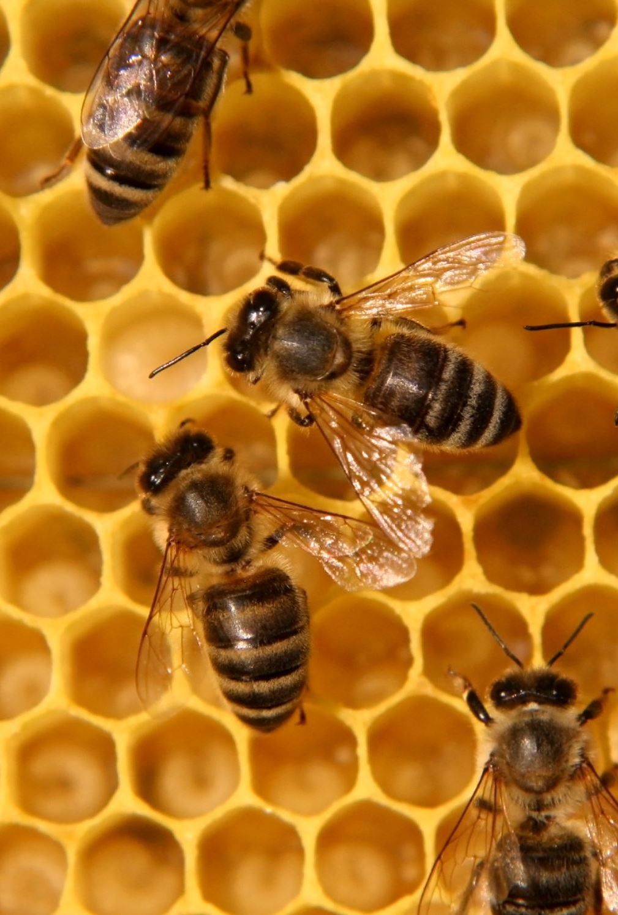
Production Process
Beekeeping: The bees are kept in an environmentally clean area, with minimal use of chemicals. This approach ensures that Unmedy’s products are natural and free from pesticide contamination.
Honey Harvesting: Honey is harvested using traditional methods, ensuring that the bees are not disturbed and their natural cycle is preserved. The honey is then filtered to remove impurities while retaining all its beneficial properties.
Propolis and Beeswax Production: Propolis is collected from the hives and processed into tinctures and other products. Beeswax is cleaned and melted, ready for use in cosmetics, candle-making, and beeswax wraps.
Honeycomb and Beeswax Wraps: Honeycomb is carefully separated and packaged to maintain its natural structure and properties. Beeswax wraps are made by melting and applying beeswax to natural fabric, ensuring their durability and reusability.

Slide 9

Environmental Impact of Production
Unmedy Beekeeping is committed to minimizing its environmental impact and contributing to sustainability:
Biodiversity Protection: The beekeeping process supports pollination in the region, aiding local flora and fauna. This helps to actively protect biodiversity.
Eco-Friendly Beekeeping: The use of ecological and sustainable practices in beekeeping reduces environmental impact, aligning with the goal of sustainability and nature conservation.
Energy Efficiency: The beekeeping operations utilize energy-efficient techniques and equipment, reducing energy consumption and CO2 emissions.

Slide 10
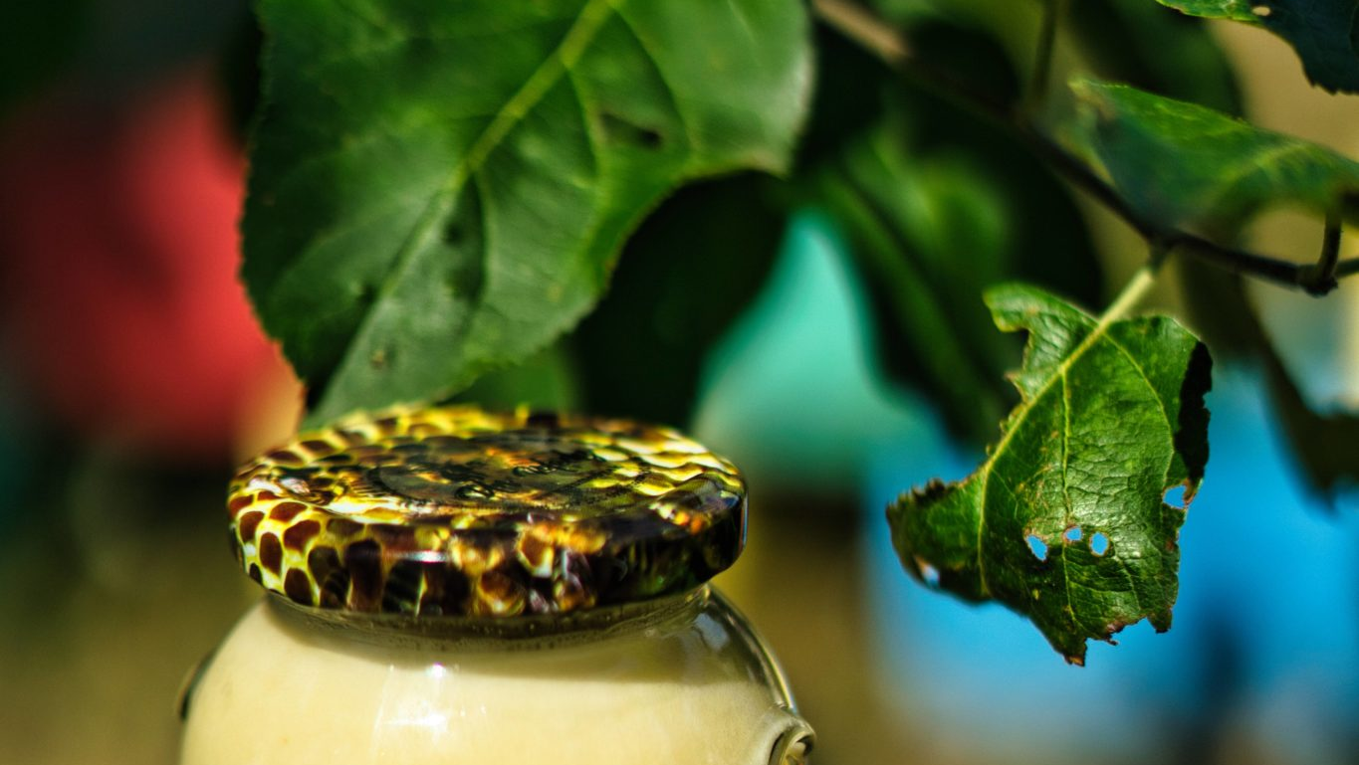
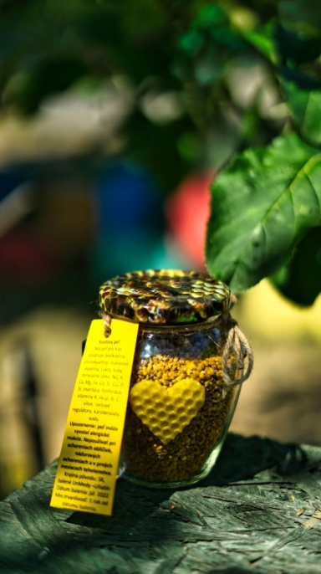
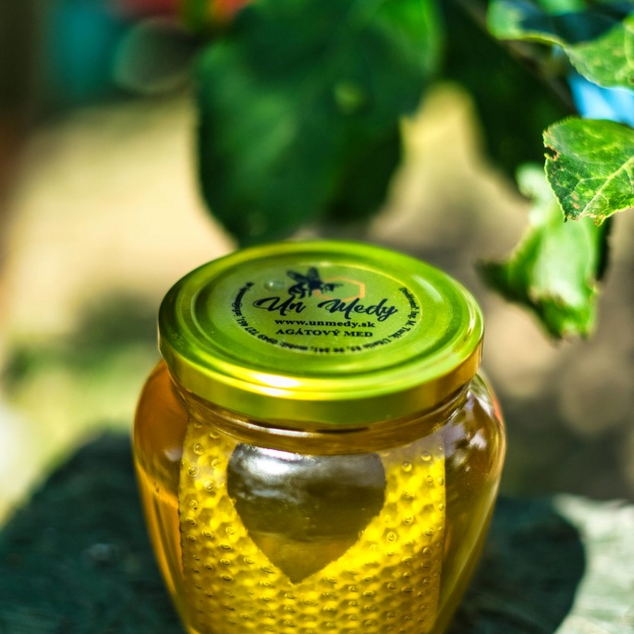
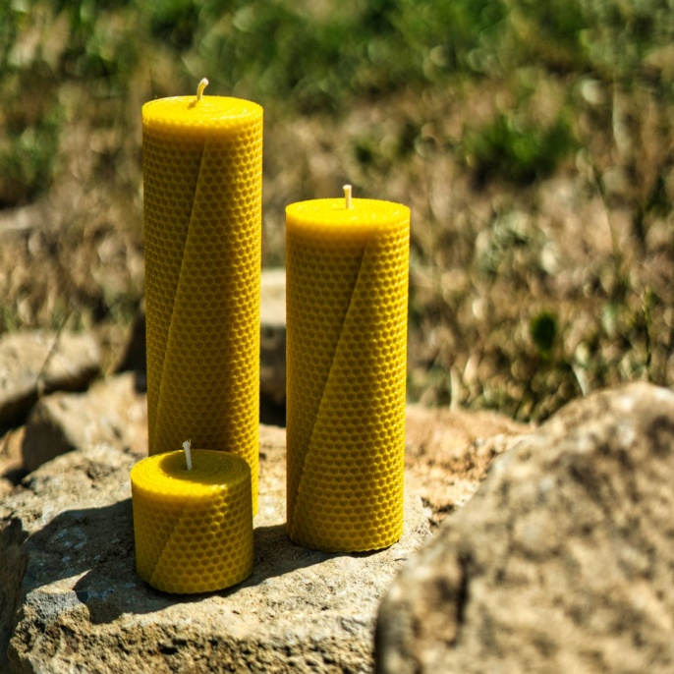
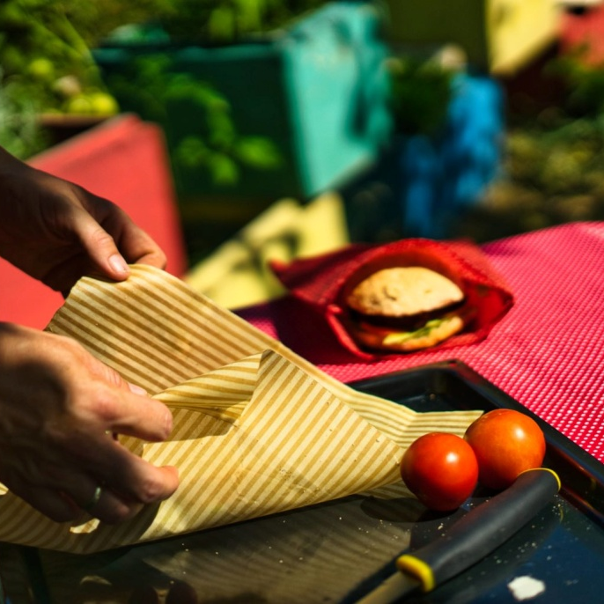
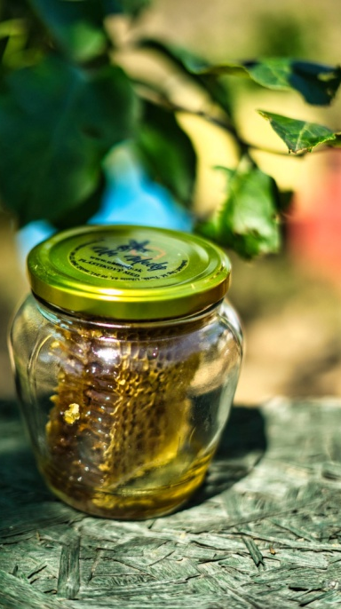
Unmedy Beekeeping provides high-quality natural products while emphasizing sustainability and environmental protection in the region.

Slide 11
Waste Management
Recycling: By-products such as beeswax are recycled and reused in other products, minimizing waste.
Composting: Organic waste generated during the processing of honey and wax is composted, enriching the soil and reducing overall waste.
Waste Reduction: Unmedy Beekeeping strives to minimize waste at every step of the production process and actively encourages recycling among its customers.

Slide 12
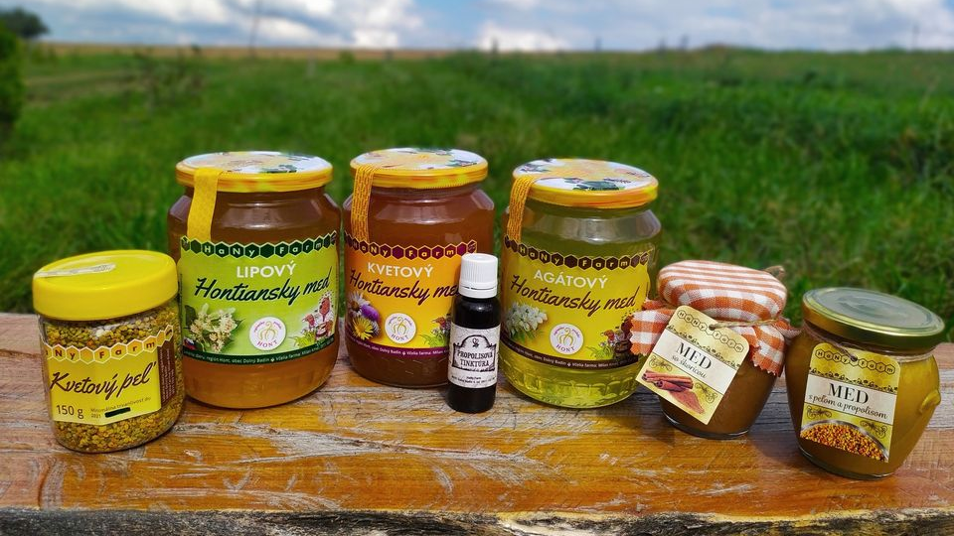
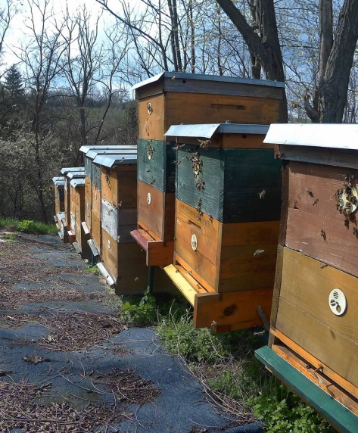
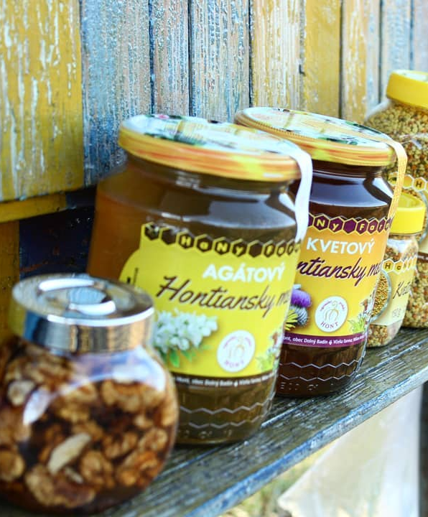
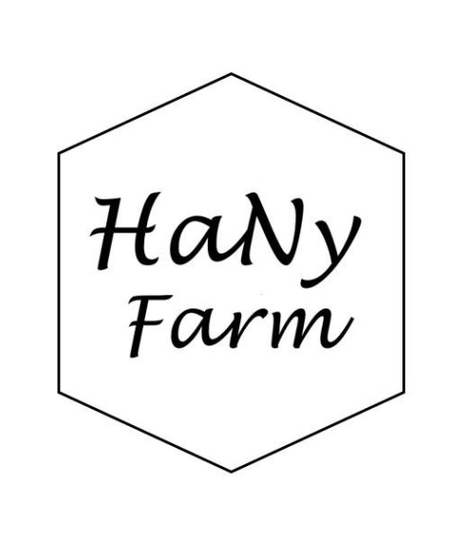
HaNy Farm
HaNy Farm is a family honey farm.
They have got one of the best honey and you can see how the beekeeper works and you can also see where their bees are living.
This family honey farm is close to castle Čabraď and castle Bzovík.
HaNy farm is situated in the middle of undamaged nature without any chemicals.
Their bees are not near any big town, so this is the best environment for live of bees.

Slide 13
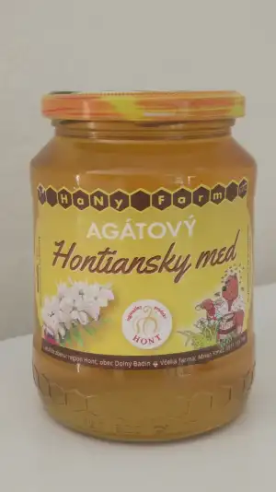
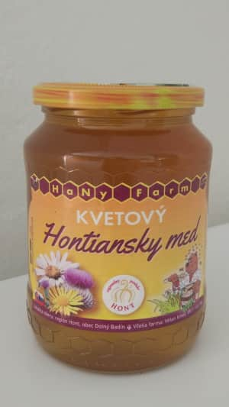
Products:
AGATE HONEY
It is a very popular, delicate and delicious honey.
It contains a large proportion of easily digestible sugars and is low in enzymes.
It is characterized by a high fructose content, which results in a very long crystallization.
FLOWER HONEY:
Flower honey is characterized by a higher content of simple sugars and a lower content of minerals compared to honeydew honey.
Therefore, it is easier to digest and very valuable in natural medicine

Slide 14
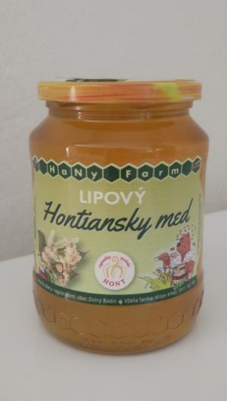
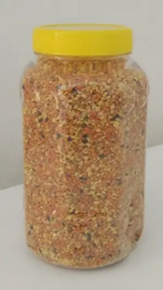
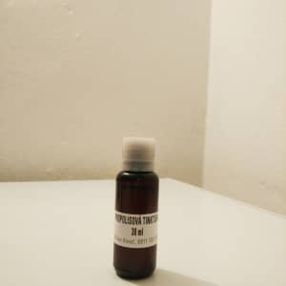
Products:
LINDEN HONEY
It is considered one of the best types of honey.
It has an amber yellow hue and is very rich in vitamins of group B1, also known as thiamine.
It is best used for colds, flu or bronchitis.
It has excellent antiseptic properties and is recommended to be eaten by people who suffer from insomnia and stress.
PROPOLIS TINCTURE
Propolis tincture can significantly increase the body's defenses, accelerate regeneration and help in the risky "flu period".
So if you have an immune problem and are often sick, propolis is a suitable solution to help with treatment or prevention.
It will also help with various inflammations, whether of the teeth or skin.
DRIED POLLEN
Pollen has a great biological effect. It contains the richest known source of vitamins, minerals, proteins, amino acids, enzymes and fats, as well as a significant amount of natural antibiotics

Slide 15
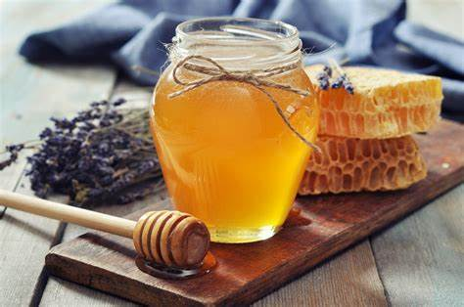
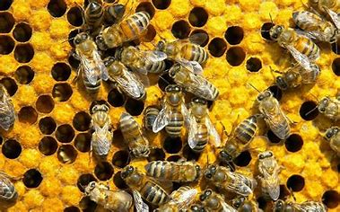
What they do with waste and unnecessary residues?
As far as waste is concerned, they strive for maximum recycling and nature conservation.
They pack and ship packages in paper boxes.

Slide 16
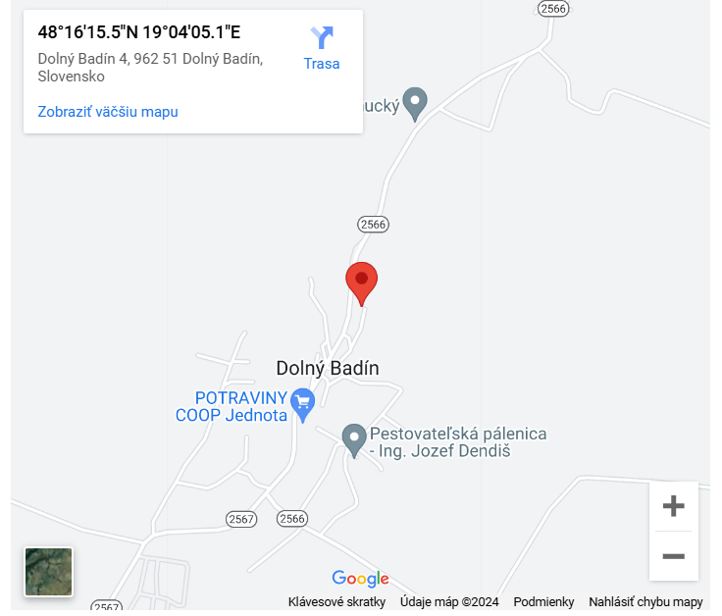
Where can you find a HaNy Farm?

Slide 17
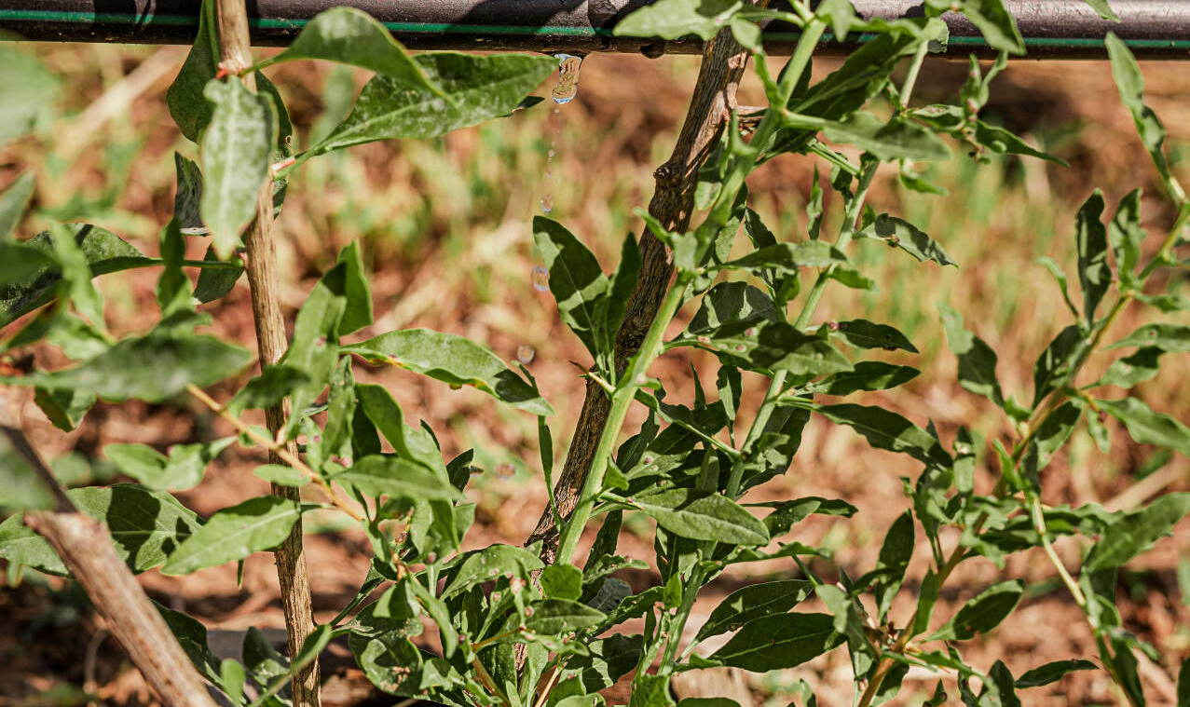
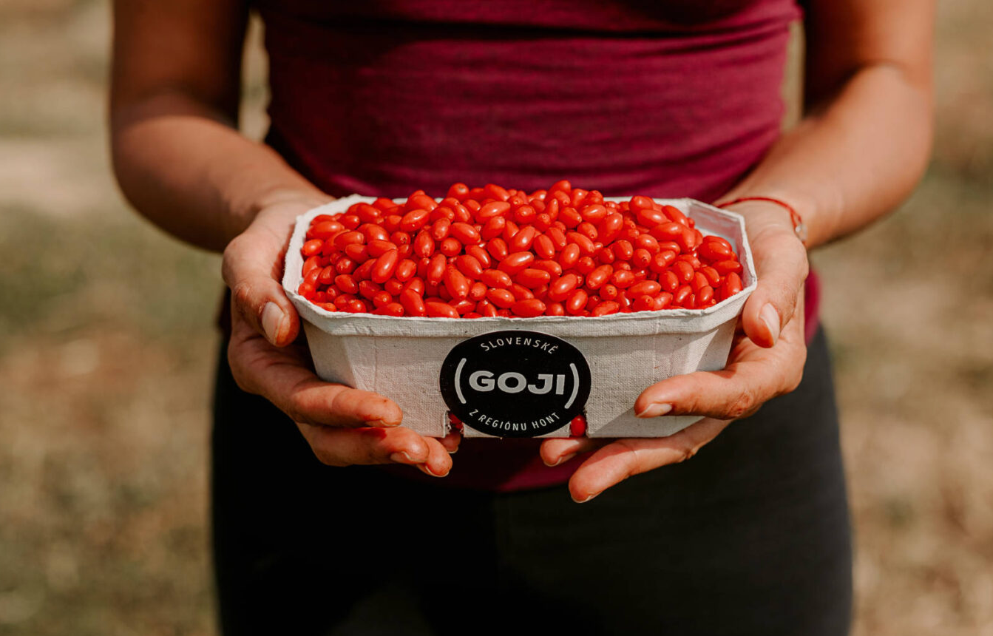
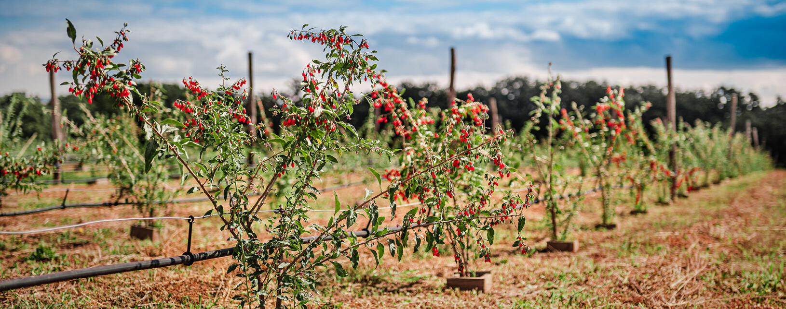
GOJI from the Hont region
They are a small family farm in the village of Domaníky that hides red diamonds.
A few years ago, young farmers came up with the idea to plant seedlings of the amazing and miraculous crop GOJI BERRY in the sun-drenched Hont.
The first 100 certified seedlings took root very well, and so the organic orchard grew by more than 1000 more bushes of miraculous fruits and the healing power of nature.
The rich harvest of goji berries has been transformed into natural products - fresh goji, ground goji, loose goji tea, whose unmistakable taste changes a little from year to year - according to the current growing conditions in the given year.
What does not change is the health, vitamins and strength hidden in every red berry.

Slide 18
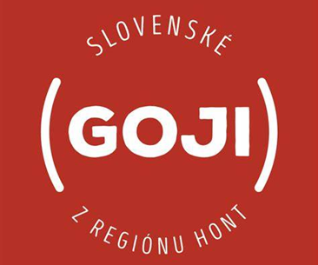
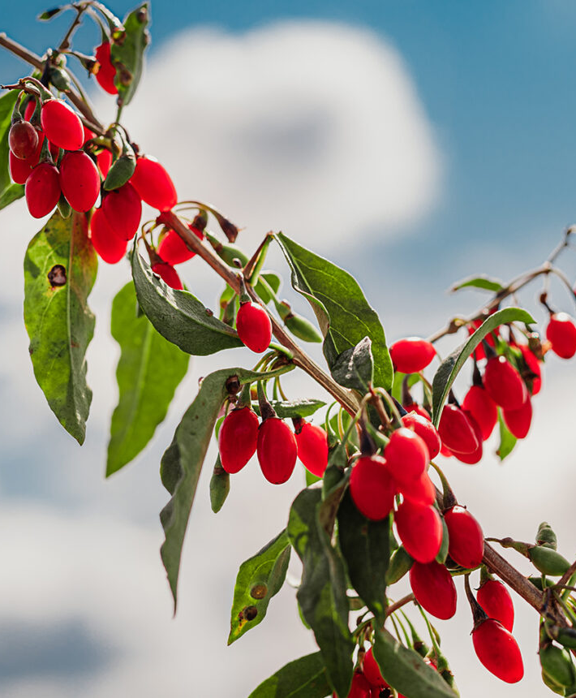
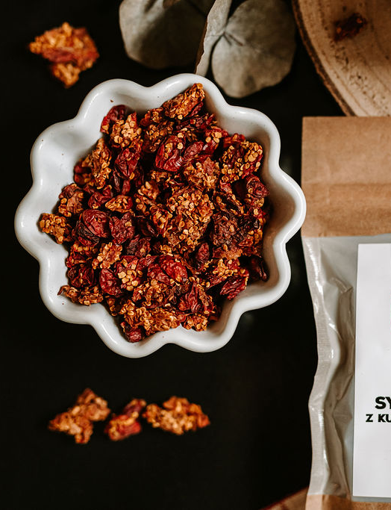
What exactly is GOJI berry?
GOJI BERRY is a berry of deep red color with an oval shape.
It has a specific taste that goes from sweet to slightly bitter.
This fruit is considered the fruit of the century or a vitamin bomb in the world due to its properties.
The GOJI BERRY plant comes from Tibet in the Himalayas and has been considered there for many centuries not only as food but also as a medicine.
In Chinese traditional medicine, this fruit is nicknamed the Red Diamond and is considered a natural aid in revitalizing the overall health of the body.

Slide 19
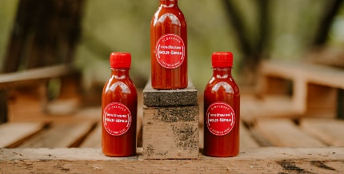
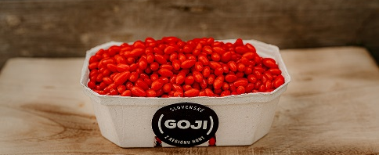
Products:
100% Juice mix GOJI-ARROW
Fresh GOJI BERRY

Slide 20
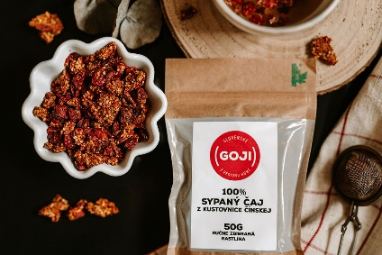
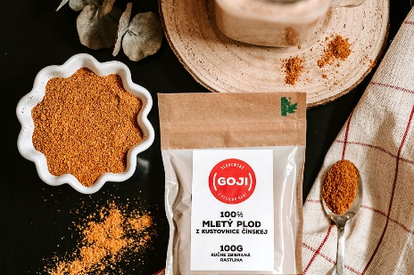
Products:
100% Loose tea from the fruits and seeds of Lycium
100% GROUND FRUIT

Slide 21
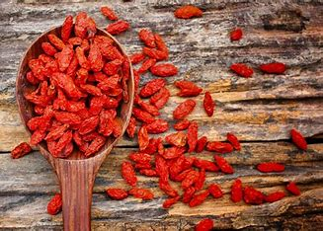
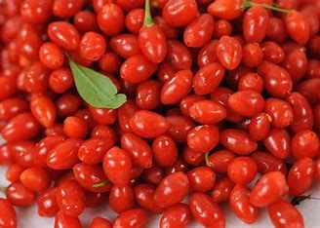
What they do with waste and unnecessary residues?
They use compost, pack them in ecological boxes.
I would say that they are very interested in the nature around them because they draw from it.

Slide 22
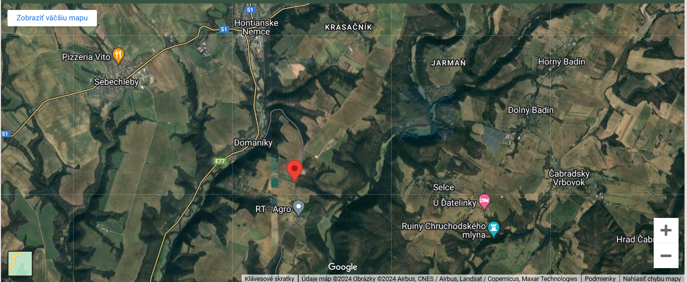
Where can you find GOJI from the Hont region?

Slide 23
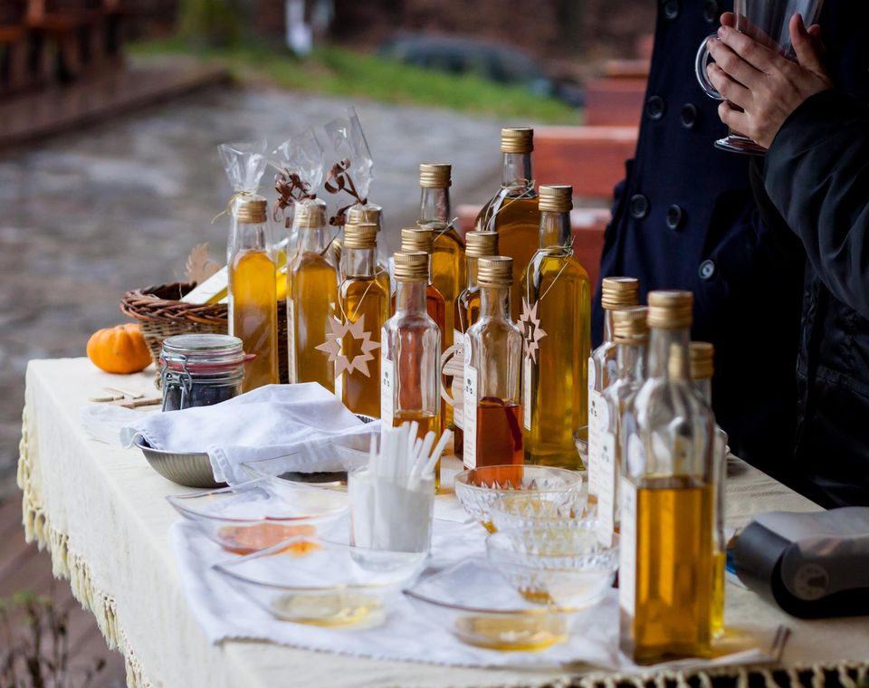
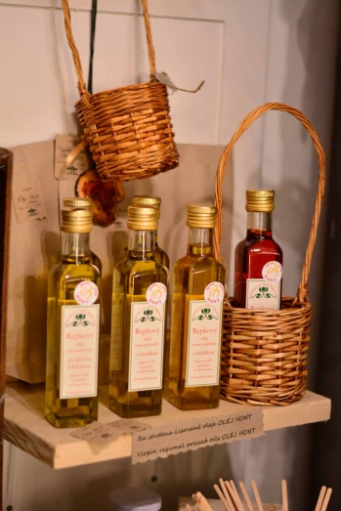

Olej HONT
Hont Oil is a small, regional producer of cold-pressed vegetable oils of the highest quality, and we are completely committed to the country in which we live.
From here they draw their raw materials, whenever possible, from the Hont region.
Anyway, with a 100% guarantee from Slovakia.
Just as the connection to the region is important to them, the quality of their products is also important to them. And for us, quality means the following:
They choose the raw material for pressing exclusively from small, responsible growers whom they know personally and who value the land on which they grow.
This raw material does not travel half the world, at most half of Slovakia, or it is even grown here around the corner.
The seeds are carefully inspected before pressing.
The production of oils takes place exclusively by a single cold pressing in a screw press of the latest generation.
A careful and gentle pressing process, in which they care about quality, not quantity, guarantees the top quality of these oils.
This applies to the taste, color, smell and valuable substance content of natural vegetable oils.
After pressing, they do not filter the oils, but simply let them sediment, thus preserving the power of nature hidden in cold-pressed oils.
After sedimentation, the oil is bottled by hand.

Slide 24
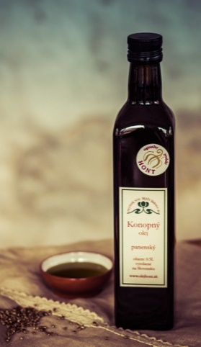

Products:
Hemp oil:
it is pressed from hemp seeds grown either in the Hont region or elsewhere in Slovakia.
Like all our oils, it is pressed in a gentle way and is unfiltered, where all valuable substances in the oil are preserved.
It is popularly called a "blood vessel brush" – it cleanses blood vessels from clogging, helps the patency of blood vessels, and thus improves blood cholesterol levels and lowers blood pressure, helps with varicose veins, helps in the treatment of cardiovascular diseases and cardiac arrhythmia, in the treatment of diabetes.
It has strong anti-inflammatory, antifungal and regenerative effects - it helps with atopic eczema, psoriasis, or psoriasis. It supports the establishment of hormonal balance, especially during menopause, strengthens the immune system and blocks allergic reactions. Hemp oil also visibly improves the quality of hair and nails

Slide 25
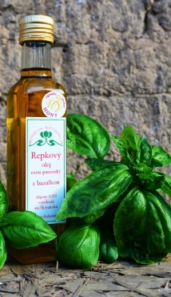
Products:
Canola oil
received the "Hont Regional Product" certificate.
it is pressed using a gentle cold method
It is made without heat treatment and any chemical treatment.
is unrefined and unfiltered oil
With this production process, all valuable substances are preserved in the oil.
With its composition, it has a beneficial effect on the cardiovascular system, blood pressure, blood cholesterol levels, metabolism and digestion, memory, proper development of muscles, red blood cells, proper function of cell membranes, vision, as well as the overall external healthy appearance of the body, as it slows down skin aging, strengthens hair and nails, helps with skin diseases

Slide 26
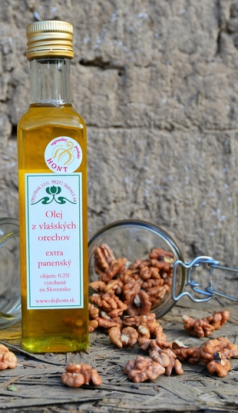
Products:
Walnut oil:
it is pressed by a gentle cold method, the first pressing
It is made without heat treatment and any chemical treatment
is unrefined and unfiltered – they let the oil settle naturally
With this production process, all valuable substances are preserved in the oil - it has a high content of trace elements, iron, vitamins and antioxidants
The oil has a beneficial effect on the central nervous system and brain function, improves memory, increases the ability to concentrate and can regenerate brain cells.
Thanks to its high iron content, it can also cope with anemia.

Slide 27
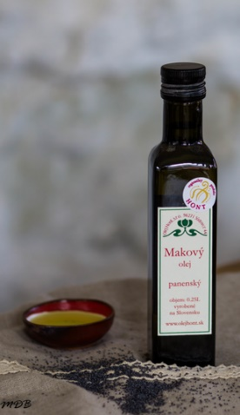
Products:
Poppy seed oil
we press from blue poppy grown in Slovakia
It is made by a single cold pressing, without chemical and heat treatment
The substances contained in poppy seed oil help the effective absorption of calcium into the bones, is an effective fighter against osteoporosis, prevents tooth decay, relieves muscle spasms
It has a calming effect on the psyche, counteracts stress, increases mental resilience, but has no intoxicating effects
Due to its composition, it is predestined for the care of the skin, hair and nails, the essential fatty acids contained in the oil also nourish and moisturize the skin, effectively regenerate the skin, leaving it soft and supple, it is suitable for normal, dry but also eczematous skin, in combination with rose water it smoothes wrinkles around the eyes
It is ideal for mothers at the time of breastfeeding, as well as for infant nutrition
It is suitable for massage mixtures when there is tension in the neck and head area, thus also helping with migraines, overwork, stress, it is also suitable for massage mixtures for children

Slide 28
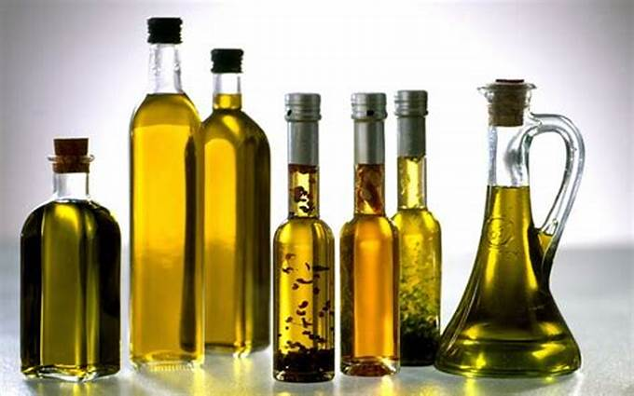
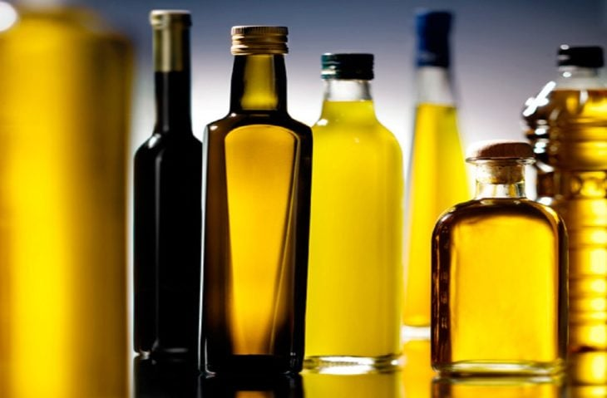
What they do with waste and unnecessary residues?
They process the used oil that they do not need and use it for further production.
It's basically recycling.
They also try to recycle waste and garbage.

Slide 29

Where can you find Olej Hont?

Slide 30



Podžobrácka farm
The Podžobrácka farm was established in 2019, they wanted to build on the once successful farming of their ancestors.
At present, they present themselves as a small family business and are engaged in the production of high-quality fruit spirits in almost organic quality from rowan, rose hips, and quince.
They are not only exceptional in taste and aroma, but also in the type of fruit we use to make them.
These are fruits that they harvest every year on our farm and in the cadastre of the village of Vinica.

Slide 31

Services:
Podžobrácka farma s.r.o. offers rent, part of the property - a building with a representative room in a pleasant environment, in nature, in the vineyard area, of the village of Vinica.
The building is suitable for a smaller group.
A representative room with a capacity of 20 seats is used for rent for events.
In front of the building there is a smaller garden with outdoor seating

Slide 32


Products:
Oskorušovica:
Jarabina oskorušová is deciduous fruit tree growing up to 15 m in height. Its fruit is called rowan.
From a fruit growing point of view, its fruits are also interesting, which acquire a very good taste after rotting.
In Slovakia, it grows mainly in the southwest and south of the country.
The fruits of rowan are highly variable.
We know pear-shaped and apple-shaped fruits, which can be yellow to crimson red.
The largest fruits are the varieties "Sossenheimer Riesen" from Germany, Parochiane and Indignente from Sicily, which we also grow in our orchards.
Trnkovica:
Blackthorn is a shrub about 2 m tall, very branched with thick thorns and ovate, serrated leaves.
The snow-white, five-petalled flowers grow even before the foliage and cover the entire branches individually.
The fruit ripens into a black, blue-innovative, bitter drupe, which wrinkles after the first frosts, acquires a sweet bitter taste.
For its kvass, only fruits that have passed the first frosts on the bushes are used.

Slide 33

Products:
Dulovica
Quince is one of the typically autumn fruits and is a full-fledged fruit, although today it is no longer one of the common fruits of our gardens, in the past it was different.
It comes from Transcaucasia, Iran, Turkestan, then spread from Asia Minor to other countries.
This is probably how it got to southern Europe.
In Slovakia, it is grown as a curiosity in wine-growing areas.
In Central Europe, it is grown for decoration, since the fruits have trouble ripening.
The fruits are used for the production of delicious compotes and, thanks to the high content of pectins, also for the production of marmalade, or in our case for a quality distillate.

Slide 34

Where can you find Podžobrácka farm

Slide 35

Felix′s farm
Company description:
It is located in the village Horné Mladonice
They breed goats and produce goat milk products
They produce: pasteurized goat's milk, milk yogurt drink, bryndza, fresh cheeses, steamed cheeses, grilled cheeses, smoked cheeses, cheeses in brine or in oil
It is a family business
It was founded in 2022

Slide 36
Obtaining material
The main ingredient, goat's milk, is obtained by milking goats on the farm. Other raw materials or material that is necessary for production, such as rennet, calcium chloride, dairy cultures, packaging materials are ordered from specialized stores or farm shops.

Slide 37
Product manufacturing process
Every morning and every evening the goats are milked and the milk is cleansed through a machine designed for this purpose.
Then the milk is processed according to what is to be done. Either it is only pasteurized or other products are made from it.
If cheese is made, the milk is pasteurized and then cooled.

Slide 38
Next, the milk is vaccinated with a dairy culture.
Add calcium chloride, rennet and wait approximately 20 minutes for the cheese to curdle.
Then it is cut, wait a while and the cheese is mixed again. All of this has its own process in order for the cheese to have the right consistency.

Slide 39

When the cheese is curdled, as it should be, it is then placed in forms, allowed to drain and finally rotated.
Once the cheese is drained, it is packed, weighed, labeled and distributed the next day.

Slide 40



Sample products

Slide 41


Workspace

Slide 42

Disposal of created waste
Waste remains from packing products. Plastic and paper remain. It is separated and then exported.

Slide 43
Benefit for our region
In my opinion, this manufacturer has a good benefit for our region, because it sells quality products, that cannot be bought just anywhere.
People don't have to go far, if they want to try a homemade product of this type.

Slide 44



Víno Lauko

Slide 45

Products of Víno Lauko
Víno Lauko is a small, family-owned winery located in the Hont region of Slovakia, known for its commitment to producing high-quality natural wines. Their products include:
Natural White Wines: These are made from local grape varieties, such as Welschriesling and Green Veltliner. The wines are known for their crisp acidity, minerality, and fresh, aromatic profiles.
Natural Red Wines: Produced from regional grape varieties like Blaufränkisch, these wines are characterized by their deep color, robust tannins, and complex flavor profiles, often featuring notes of dark fruit, spice, and earth.
Rosé Wines: The rosé wines are made using the saignée method, where juice is “bled off” from the red wine fermentation process. These wines are typically dry, with vibrant acidity and flavors of red berries and flowers.
Sparkling Wines: Produced using the traditional method (Méthode Champenoise), these wines undergo a secondary fermentation in the bottle, resulting in fine bubbles and a creamy texture. The sparkling wines often have a delicate balance of fruitiness and yeastiness.

Slide 46






Slide 47
Production Process
The winemaking process at Víno Lauko is deeply rooted in natural and sustainable practices, with an emphasis on minimal intervention:
Winemaking at Víno Lauko: A Natural Approach
Organic Grape Cultivation: No synthetic chemicals, promoting soil health through cover crops and compost.
Hand Harvesting: Grapes are picked at peak ripeness to ensure top quality and reduce waste.
Natural Fermentation: Wild yeasts on grape skins allow wines to reflect their terroir and vintage.
Minimal Intervention: No filtering, fining, or significant sulfites, preserving natural flavors and textures.
Aging: Wines age in stainless steel or old oak barrels, enhancing complexity.
Bottling: Bottled with care to preserve the wine’s natural integrity without filtration.

Slide 48
Environmental Impact of Production
Sustainability at Víno Lauko
Organic Farming: No synthetic pesticides, promoting biodiversity and soil health.
Water Conservation: Drip irrigation and rainwater harvesting reduce water usage.
Energy Efficiency: Natural cellar cooling and solar energy cut down on energy use.
Reduced Carbon Footprint: Local sourcing and eco-friendly transport minimize carbon emissions.

Slide 49
Waste Management
Organic Waste Recycling: The by-products of winemaking, such as grape skins, seeds, and stems, are composted and returned to the vineyard as natural fertilizer. This practice reduces waste and enhances soil fertility.
Packaging: Víno Lauko uses recyclable and sustainable packaging materials. For example, they use lightweight glass bottles to reduce the carbon footprint of transportation. The winery also explores using biodegradable corks and labels to further reduce environmental impact.
Waste Reduction: The winery is dedicated to minimizing waste throughout the production process. They strive to reuse materials whenever possible and recycle what cannot be reused. This includes everything from office supplies to production waste.

Slide 50



The Wine cellar

Slide 51
Through its dedication to natural winemaking and sustainable practices, Víno Lauko not only produces exceptional wines but also ensures that its operations positively contribute to the environment and the local community.
Their approach to waste management and environmental stewardship makes them a model of sustainable winemaking in the Hont region.

Slide 52


RNDr. Róbert Lauko
+421 905 777 967
robolauko@robolauko.sk
Facebook: Víno Lauko

Slide 53




SEBECHLEBY
Vatra Design is a company specializing in artistic blacksmithing, metalworking, and family winemaking. It combines a passion for wine and its production in a small family winery with the uniqueness, creativity, and functionality of modern artistic blacksmithing.
Vatra WINE has been passed down through generations for several decades. The current owner, and dedicated winemaker Michal Vatra, has transformed it into the well-known establishment it is today. He is building and modernizing production facilities, implementing innovative solutions, and thus enhancing the quality of the wines produced. His wines are a testament to the hard and diligent work of a winemaker.

Slide 54

Vatra Design and Vatra WINE
Vatra WINE is a family winery passed down through generations. The current owner and passionate winemaker, Michal Vatra, has ensured the modernization and prosperity of this small regional winery through the production of high-quality wines and direct customer presentations at the historic winery estate, Stará Hora.
He is actively building and modernizing production facilities, implementing innovative solutions to enhance the quality of the wines. His products are a testament to the hard work and dedication of a winemaker who cultivates native grape varieties in an environmentally friendly manner to produce exceptional wines.

Slide 55

Vatra Design embodies the essence of traditional blacksmith craftsmanship.
Handcrafted metal products are created through the heat of the forge, with designs inspired by the 1960s and 1970s.
An example of their work includes the restoration of an old, neglected cellar grille:
replacing rotted and rusted parts with newly manufactured components, sandblasting and hot-dip galvanizing the metal, and finally applying a rustic paint finish and copper patina.
This process results in a masterful piece created through recycling, blending the heritage of past generations with the modern design of a skilled blacksmith.

Slide 56

Thank you for your attention.

